Slide 1
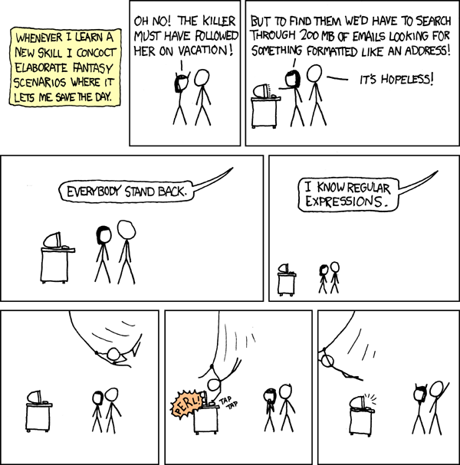

Slide 2
SI206: Discussion 8
Regular Expressions

Slide 3


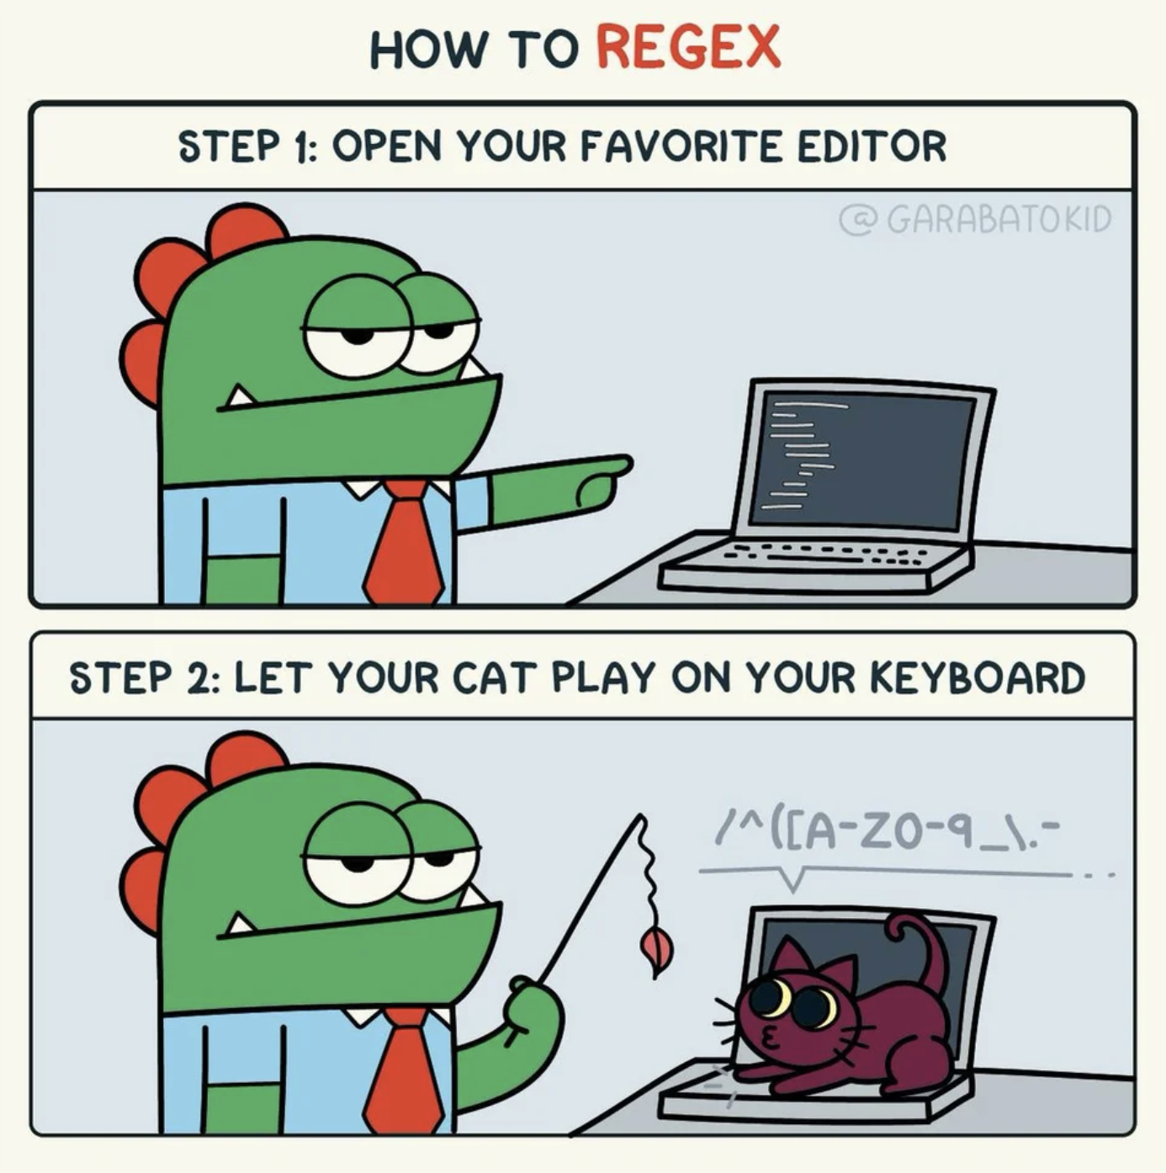
Start with regex101.com

Slide 4
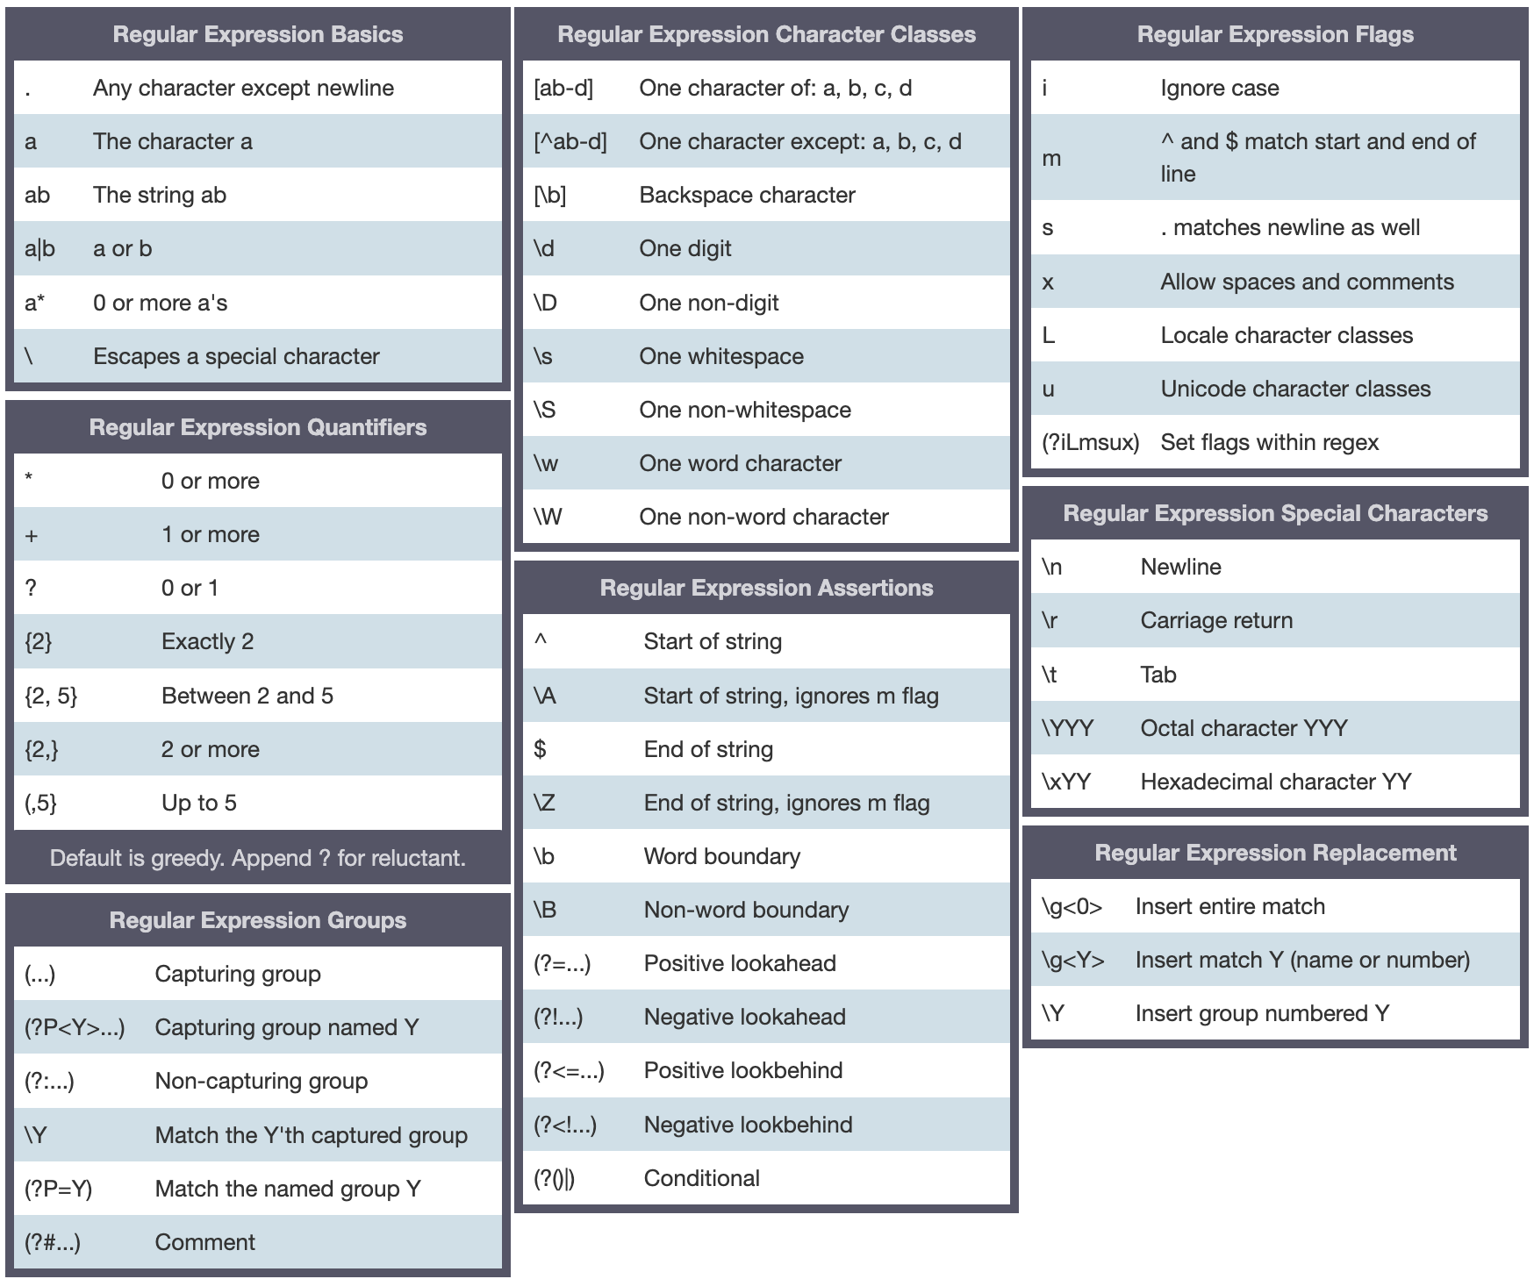
Cheatsheet: https://www.debuggex.com/cheatsheet/regex/python
Regex Documentation: https://docs.python.org/3/library/re.html

Slide 5




Tips and Advice
Think of all possible versions of the thing you’d like to retrieve
Try it out
(regex101.com)
Test yourself

Slide 6
Assignment: disc_7.py
Find all the words that contain a three-digit number in the middle
Find all days the dates format in the text are month/day/year.
The months and days can have one or two digits (ie: 1 or 01)
Find all web address domains from the list of strings. The domains of a website are what usually comes after https://www.
The web address may or may not have a www. and the protocol can either be http or https

